Slide 1
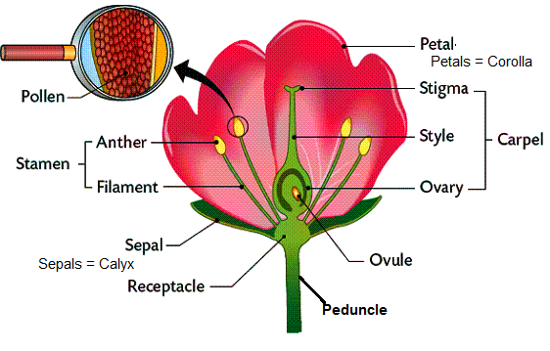
PARTS OF A FLOWER

Slide 2
Flower Part | Form and Function
Peduncle | Flower stalk.
Receptacle | Part of flower stalk bearing the floral organs, at base of flower.
Sepal | Leaf-like structures at flower base, protects young flower bud.
Calyx | All the sepals together are known as the calyx.
Petal | Located above the sepals, some are large and colourful, sometimes scented, sometimes producing nectar. Often serve to attract pollinators to the plant.
Corolla | All the petals together are known as the corolla.
Stamen | Male part of the flower, consisting of the anther and filament
Filament | The stalk which bears the anther and connects anther to the flower.
Anther | The pollen bearing portion of a stamen.
Pollen | A small circular structure containing male reproductive cells.
Carpel\Pistil | Female part of the flower. Consisting of the stigma, style and ovary.
Stigma | Top portion of the style and receptive surface for pollen grains which is often sticky.
Style | The stalk bearing the stigma connecting the stigma to the ovary.
Ovary | Enlarged lower portion of the style enclosing the ovule (s). The ovary matures to become a fruit.
Ovule | Located in the ovary. Carries female gametes. Ovules become seeds on fertilization.

Slide 3
The sex of a flower can be described in three ways:
Staminate flowers: Flowers bearing only male sex parts. These are sometime referred to as "male flowers".
Carpellate\Pistillate Flowers: Flowers bearing only female sex parts. These are sometimes referred to as "female flowers".
Hermaphhroditic\Complete flowers: Flowers bearing both male and female sex parts.
In many cases flowers are borne as a group on a common stalk, called an inflorescence. There are many different types of floral inflorescences. The type of inflorescence present is sometimes used to aid in classifying flowering plants.

Slide 4
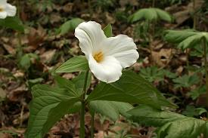
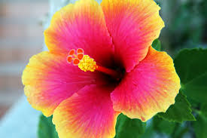
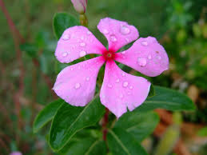
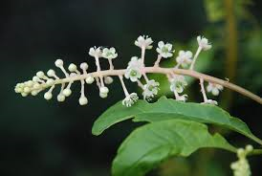
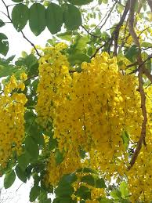
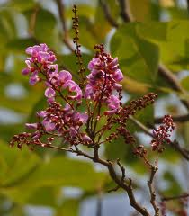

Slide 5
POLLINATION IN PLANTS
Angiosperms are highly evolved plants with well developed flowers and seeds enclosed within the fruits.
The plants usually undergo sexual reproduction.
The sexual reproduction initiates after the advent of pollination.
Pollination is the process of transfer of pollen from the anthers of a flower to the stigma of the same flower (self pollination) or of another flower (cross pollination) of the same species.
Pollination is a prerequisite for fertilization: the fusion of nuclei from the pollen grains with nuclei in the ovules. Fertilization allows the flower to develop seeds.

Slide 6
Most plants need help of pollinating agents in moving pollen from the stamens to the stigma of the carpel.
Pollinating agents may be insects, birds, animals (mammals), wind and water that move pollen from the anthers to the stigmas of flowers, thus effecting pollination. E.g. bees, butterflies, hummingbirds, moths, house flies, some wasps, and nectar feeding bats.
The flowers of these plants have peculiar characteristics which can help in successful pollination.

Slide 7
Insect Pollinated flowers
Characteristic features of insect pollinated flowers:
Flowers are brightly coloured and/or strongly scented
Flowers have nectar glands which produce sugary nectar that attracts insects. Pollen is deposited on the insect from the stamens when it visits the flower to collect or suck the nectar and is deposited on the stigma of the next flower of the same species the insect visits

Slide 8
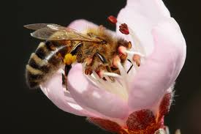
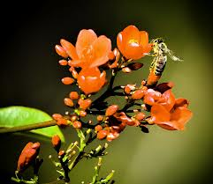
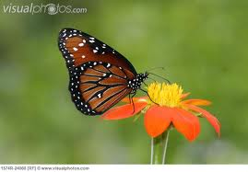
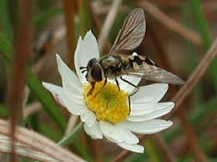
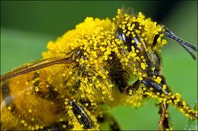
POLLINATION BY INSECTS

Slide 9
Bird pollinated flowers
Characteristic features of bird pollinated flowers:
They often have colourful corolla, calyx, or stamens which are attractive to birds
They are often not scented
The petals are fused at the base to form a tube or cone known as corolla tube which allows penetration of the bird’s beak to collect nectar from base. As the bird picks the nectar, it brushes against anthers picking up pollen on the beak and body. When the bird visits another flower of same species, the pollen gets deposited on the stigma of the second flower
Stamens occur inside the corolla tube
These types of flowers provide a large amount of nectar as reward for the bird pollinators

Slide 10
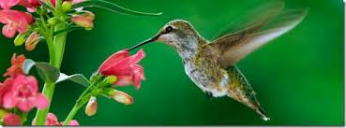
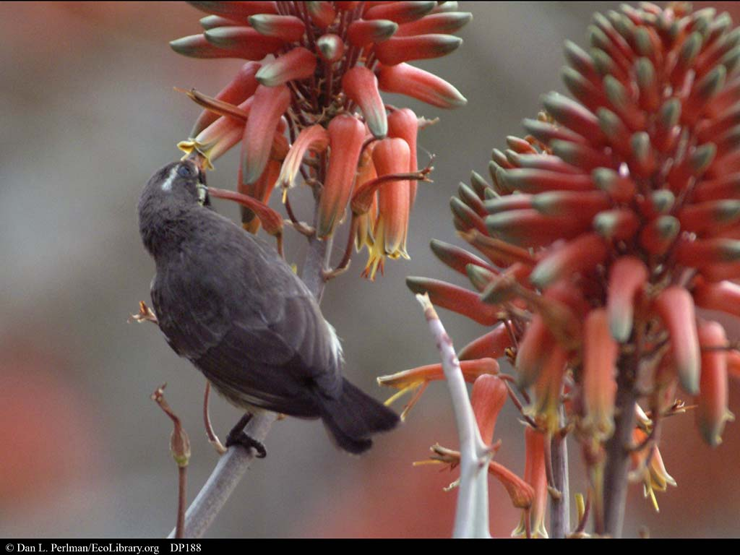
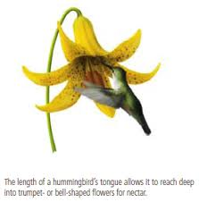
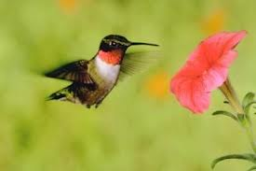
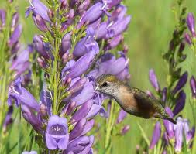
POLLINATION BY BIRDS

Slide 11
Water pollinated flowers
Characteristic features of water pollinated flowers:
The flowers release their pollen into the water which is passively carried to other flowers by water currents
They produce a large number of pollens because most of them get lost in the water flow.
The pollen grains are often light in weight and have water proof coating
The stigmas are large and feathery to catch the pollens.
In some species, the male flowers after maturation get detached from the mother plant and float 0on the water surface.
The stalk of the pollinated flowers are usually very long to project their stigmas above the water surface to receive pollen from male flowers.
The flowers need not to be colorful (no need to attract) and generally white in color

Slide 12
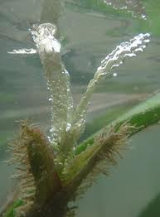
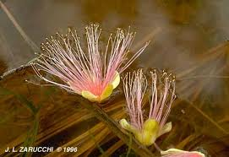
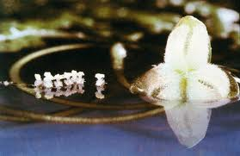
POLLINATION BY WATER

Slide 13
Wind pollinated flowers
Characteristic features of wind pollinated flowers:
They produce huge amounts of non sticky pollen
They often lack a large and showy calyx or corolla
They have many flowers packed into an inflorescence
They have large stigmas
They have large, well exposed anthers

Slide 14
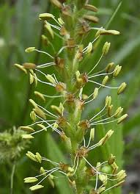
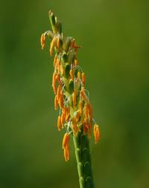
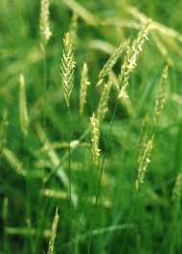
POLLINATION BY WIND

Slide 15
Mammal (animal) pollinated flowers
Characteristic features of mammal (animal) pollinated flowers:
They often have a strong scent e.g. those which attract mice have a yeasty odour
The flowers are often relatively large in size
The petals fuse into a wide tube or cone-like shape which allows mouth parts of mammals like bats, mice to penetrate and suck the nectar situated at the base of the corolla tube
They are quite sturdy in structure in order to bear the vigorous activity of the small mammals while they are feeding on the nectar

Slide 16
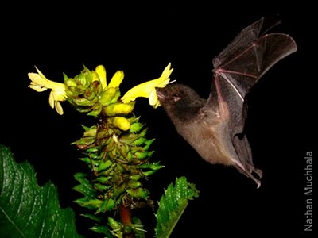
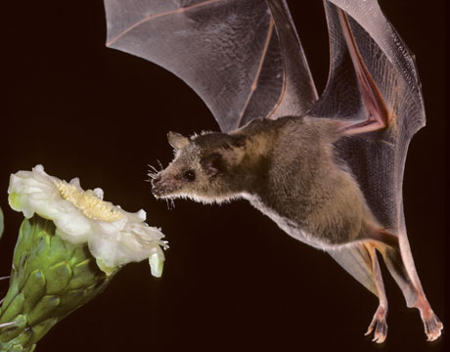
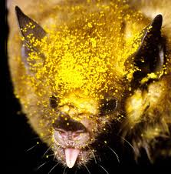
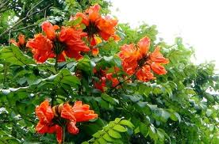
POLLINATION BY BATS

